Slide 1
Constraint Satisfaction Problem in AI
Course Name: Artificial Intelligence
Course code: CSE-403 [ SECTION - A ]
Khandaker Jannatul Ritu, Lecturer Dept. of CSE at BAIUST

Slide 2
Constraint Satisfaction Problem in AI
The goal of AI is to create intelligent machines that can perform tasks that usually require human intelligence, such as reasoning, learning, and problem-solving. One of the key approaches in AI is the use of constraint satisfaction techniques to solve complex problems.
CSP is a specific type of problem-solving approach that involves identifying constraints that must be satisfied and finding a solution that satisfies all the constraints. CSP has been used in a variety of applications, including scheduling, planning, resource allocation, and automated reasoning.
There are mainly three basic components in the constraint satisfaction problem:
Variables: The things that need to be determined are variables. Variables in a CSP are the objects that must have values assigned to them in order to satisfy a particular set of constraints. Boolean, integer, and categorical variables are just a few examples of the various types of variables, for instance, could stand in for the many puzzle cells that need to be filled with numbers in a sudoku puzzle.
Domains: The range of potential values that a variable can have is represented by domains. Depending on the issue, a domain may be finite or limitless. For instance, in Sudoku, the set of numbers from 1 to 9 can serve as the domain of a variable representing a problem cell.
Constraints: The guidelines that control how variables relate to one another are known as constraints. Constraints in a CSP define the ranges of possible values for variables. Unary constraints, binary constraints, and higher-order constraints are only a few examples of the various sorts of constraints. For instance, in a sudoku problem, the restrictions might be that each row, column, and 3×3 box can only have one instance of each number from 1 to 9.

Slide 3
Constraint Satisfaction Problem (CSP)
A Constraint Satisfaction Problem in artificial intelligence involves a set of variables, each of which has a domain of possible values, and a set of constraints that define the allowable combinations of values for the variables. The goal is to find a value for each variable such that all the constraints are satisfied.
The goal of a CSP is to find an assignment of values to the variables that satisfies all the constraints. This assignment is called a solution to the CSP.
Constraint Satisfaction Problems (CSP) representation:
The finite set of variables V₁, V₂, V₃ ……………..V_{n}.
Non-empty domain for every single variable D₁, D₂, D₃ …………..D_{n}.
The finite set of constraints C₁, C₂ …….…, Cm.
where each constraint C_{i} restricts the possible values for variables,
e.g., V₁ ≠ V₂
Each constraint C_{i} is a pair <scope, relation>
Example: <(V₁, V₂), V₁ not equal to V₂>
Scope = set of variables that participate in constraint.
Relation = list of valid variable value combinations.
There might be a clear list of permitted combinations. Perhaps a relation that is abstract and that allows for membership testing and listing.

Slide 4
Types of Constraints in CSP
1. Unary Constraints:- A unary constraint is a constraint on a single variable. For example, Variable A not equal to “Red”.
2. Binary Constraints:- A binary constraint involves two variables and specifies a constraint on their values. For example, a constraint that two tasks cannot be scheduled at the same time would be a binary constraint.
3. Global Constraints:- Global constraints involve more than two variables and specify complex relationships between them. For example, a constraint that no two tasks can be scheduled at the same time if they require the same resource would be a global constraint.
Real-world Constraint Satisfaction Problems (CSP):
Scheduling: The constraints in this domain specify the availability and capacity of each resource, whereas the variables indicate the time slots or resources.
Vehicle routing: In this domain, the constraints specify each vehicle’s capacity, delivery locations, and time windows, while the variables indicate the routes taken by the vehicles.
Assignment: In this field, the variables stand in for the tasks, while the constraints specify the knowledge, capacity, and workload of each person or machine.
Sudoku: The well-known puzzle game Sudoku can be modelled as a CSP problem, where the variables stand in for the grid’s cells and the constraints specify the game’s rules.
Constraint-based image segmentation: The segmentation of an image into areas with various qualities (such as color, texture, or shape) can be treated as a CSP issue in computer vision.
Constraint Satisfaction Problems (CSP) benefits:
conventional representation patterns
generic successor and goal functions
Standard heuristics (no domain-specific expertise).

Slide 5
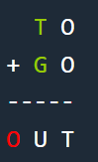
Cryptarithmetic problem in AI
Problem-01:
So final values are –
T = 2, O = 1, G = 8, U = 0
2 1
8 1
------
1 0 2
T | 2
O | 1
G | 8
U | 0

Slide 6


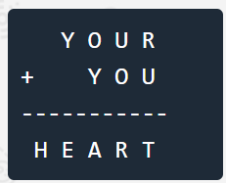
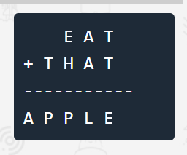
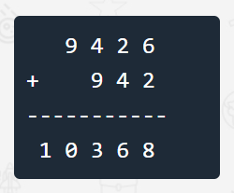
Problem-02:
The final values are –
H = 9, E = 4, R = 5, S = 8,
C = 1, O = 0, M = 3
Final Answer – H = 9, E = 0,
T = 8, S = 5, I = 6, R = 3
A = 1,
P = 0,
T = 9,
E = 8,
L = 3,
H = 2

Slide 7
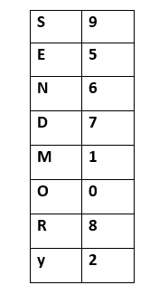

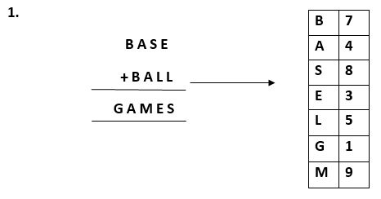
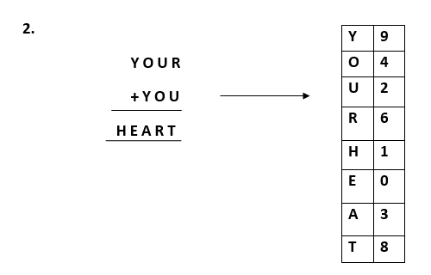

Slide 8
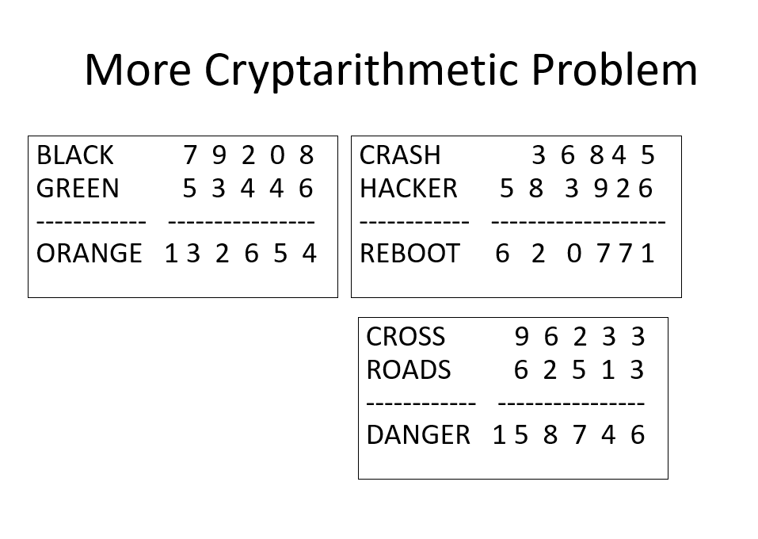

Slide 9
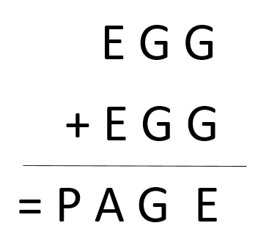
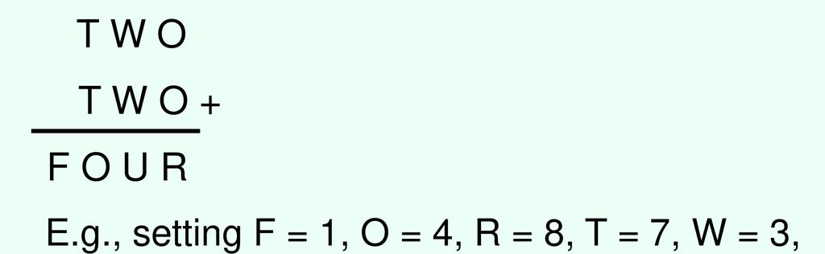
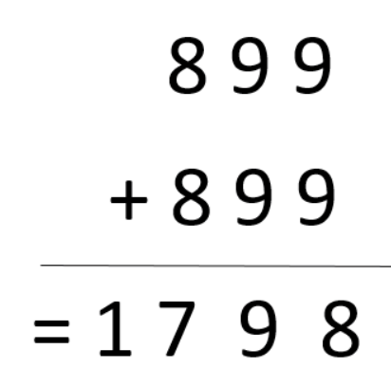

Slide 10
LOGIC
+LOGIC
________
PROLOG
so only possible combination is
90452
+90452
___________
180904

